Slide 1
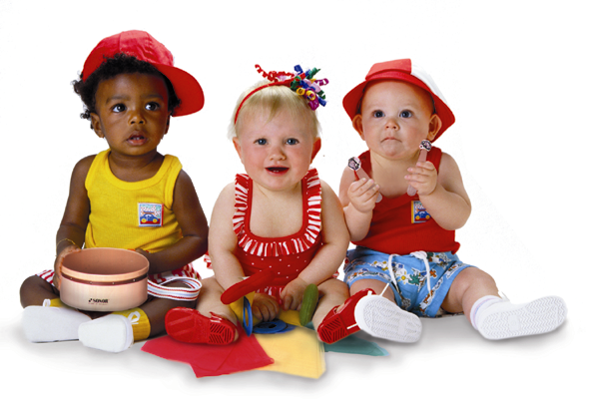

A Registered Trademark of Musikgarten U.S.A.
First attend Musikgarten, then go for Piano or Violin Lessons

Slide 2
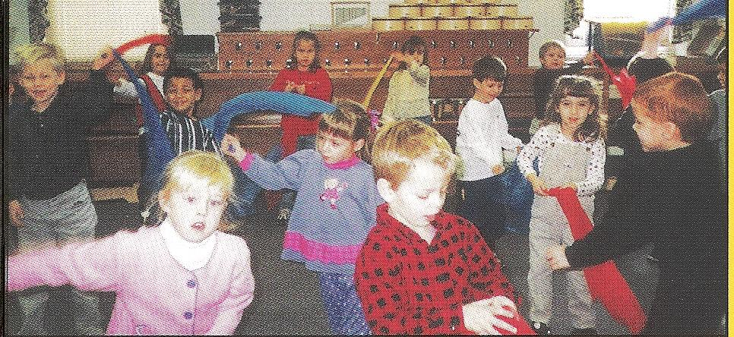
Early Childhood Music Education
Music is an important and vital aspect in the lives of young children. Young children enjoy and respond naturally to any form of musical activities, such as singing, movement, dancing and playing of instruments.

Slide 3
Early Childhood Music Education
Besides providing fun, enjoyment and pleasure, research has shown that Music & Movement activities -
Help children’s development in other areas, such as:
  Physical Development
  Socio-Emotional Development
  Cognitive/Intellectual Development
  Creative Development
Prepares a child well before learning an instrument - a strong musical foundation

Slide 4
Chart 1
Early Childhood Music
Total Development
Left Brain Right Brain
Musical Development
Lays a Strong musical Foundation
Acquire the language of music like
the mother tongue
Prepares the child well before learning
an instrument
Achieves musical literacy
– not only able to play by ear,
but also by reading notation
Analytical
Reasoning
Logical
Maths
Knowledge
Art
Aesthetic
Creativity
Emotion
MUSIC
Physical
Socio /
Emotional
Aesthetic
Intellectual /
Cognitive
Creative

Slide 5

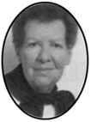
Part I - What is Musikgarten?
Overview
Founded in 1994 by Dr. Lorna Heyge and Dr. Audrey Sillick.
Based on over 45 years of applied research in early childhood education and early childhood music education.
Age appropriate learning.
Holistic child-centred approach.
Pre-instrumental music and movement program.

Slide 6
Our Founders
Dr, Lorna Heyge
Chairman and Founder
Audrey Sillick
Co-Author
Founded Musikgarten/Music Matters in 1993/1994.
Author of numerous books including Kindermusik for the Young Child and Kindermusik Beginnings.
President of the Foundation for Music-Based Learning.
Publisher of Early Childhood Connections.
Co-author of Kindermusik for the Young Child.
National Speaker and leader for music educators, Montessori educators and the Earth Education movement.
Founder and Director Emeritus of the Toronto Montessori Teacher Training Institute.

Slide 7
What is Musikgarten?
A Pre-instrumental Music & Movement program:
Builds a strong musical foundation that is essential before learning any instrument;
Develops good aural skills (help in their aural tests
– in their music examinations – ABRSM, TRINITY, etc );
Develops a good sense of rhythm and pitch;
Develops a good understanding of how to express & play music with feeling;
Exposure to composers & music of different periods (classical and contemporary);
Prepares a child well so that s/he can achieve success easily. Therefore will enjoy music lessons. Love & interest in learning an instrument will sustain (children will practice on their own).

Slide 8
The Musikgarten Curriculum
A comprehensive early childhood music program that spans the first 8 years of a child’s musical development;
It has a clear, consistent pedagogy based on understanding how children learn;
Uses developmentally appropriate materials & methods

Slide 9
The Musikgarten Courses
Family Music for Babies 30 mins., once a week Both parents to accompany baby | Birth – 16 mths
Family Music for Toddlers 30 mins., once a week Either parent to accompany child | 16 mths – 4 yrs
Musical Celebration of the Young Child – Cycle of Seasons 45 mins. , once a week | 4 – 5 ½ yrs
Music Makers at the Keyboard 60 mins., once a week | 5 ½ – 9 yrs

Slide 10
Upon Completing Musikgarten…
The children would have:
Developed good aural skills (well prepared for Aural Tests in music exams);
Developed Sight-reading & Sight-singing skills;
Learnt how to do simple Composition, Transposition, Improvisation & Dictation;
Learnt about Harmony, Chord Progression & Forms in Music, Composers & Music of different periods;
Acquired the proper keyboard / piano skills;
WELL PREPARED & READY FOR INDIVIDUAL MUSIC LESSONS.

Slide 11
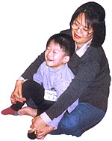
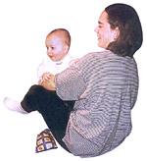
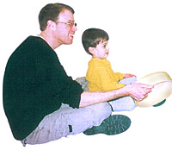
End of Presentation
Thank you.
Questions & Answer Session

Slide 12
First attend Musikgarten, then go for Piano or Violin Lessons

