Slide 1
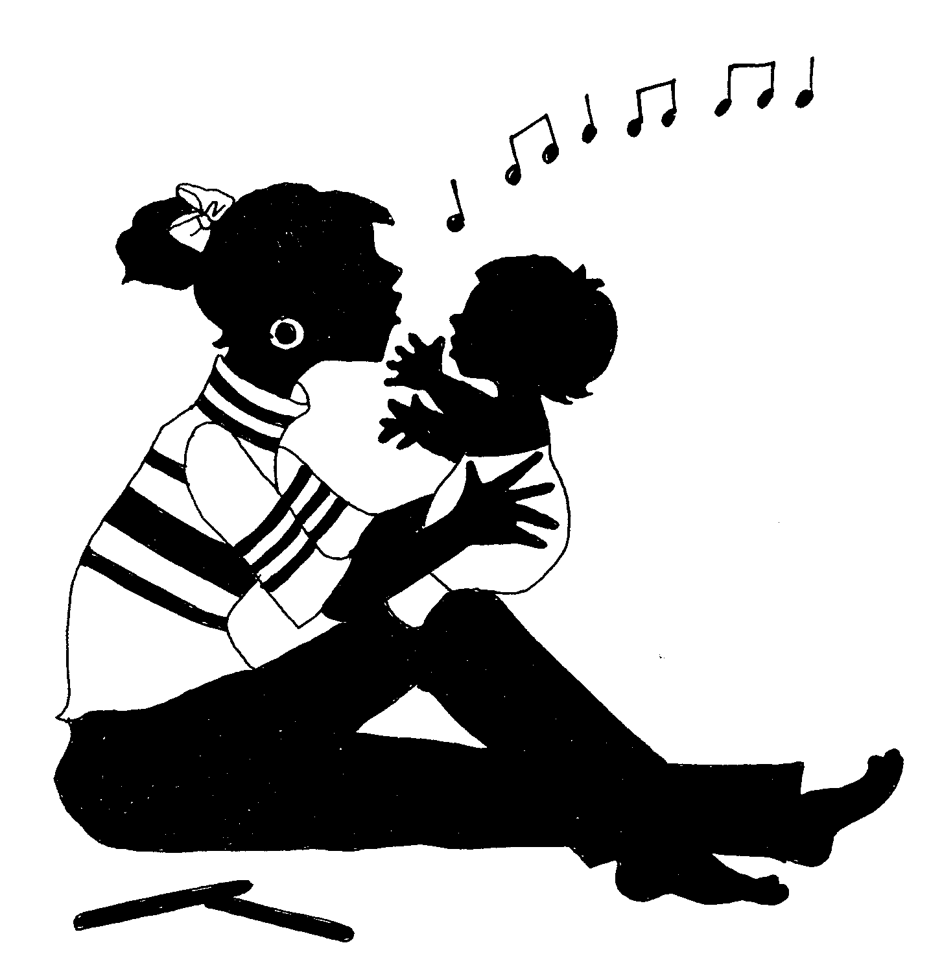
Family Music for Babies
(Newborn - 16 months)
COURSE DESCRIPTION
Parents & child develop bonding through playful musical activities:
  Bouncing and Rocking songs
  Wiggle and peek-a-boo games
  Singing, dancing and moving
  Playing of appropriate instruments
Teacher plays the role of coach;
Parents are guided on how to stimulate brain development through musical play with the babies;

Slide 2

Family Music for Babies
(Newborn - 16 months)
BENEFITS
Nurtures bonding between parents and child;
Stimulate left & right brain development;
Laying the foundation for musical growth - develops child’s listening skills, sense of pitch, flow and beat through singing, movement and dancing;
Parents learn how to play musically with the child

Slide 3


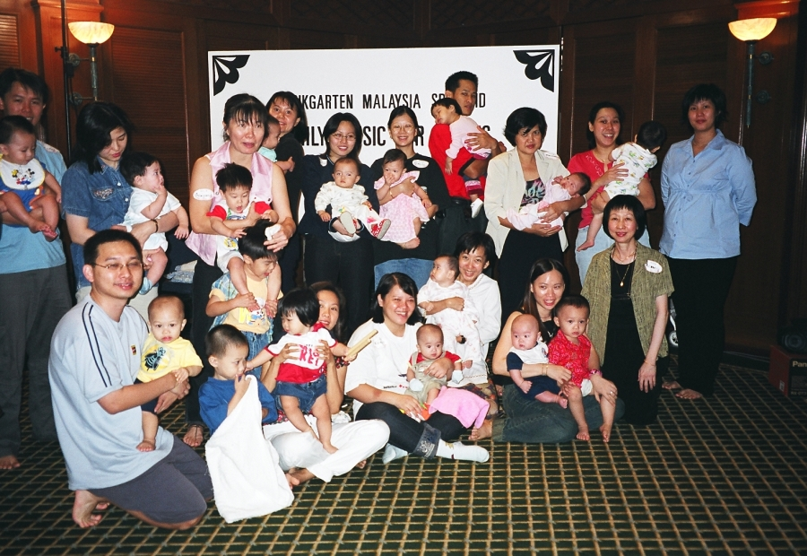
Family Music Babies – Demo Class
Group Photo

Slide 4
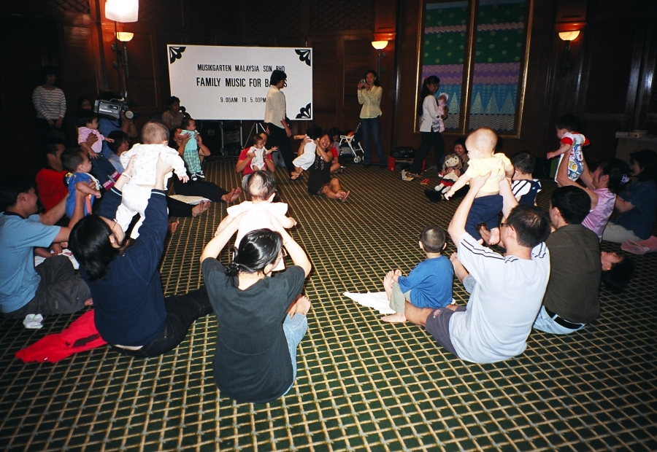
Family Music Babies – Demo Class
Bouncing activity –bonding with parent

Slide 5
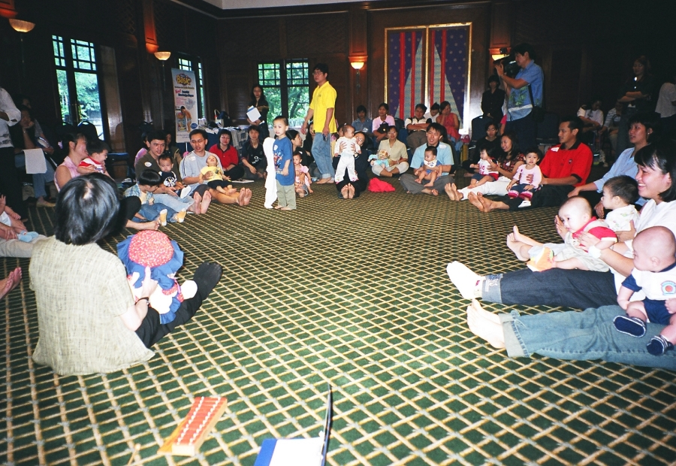
Family Music Babies – Demo Class
Bouncing activity – beat development through parent

Slide 6
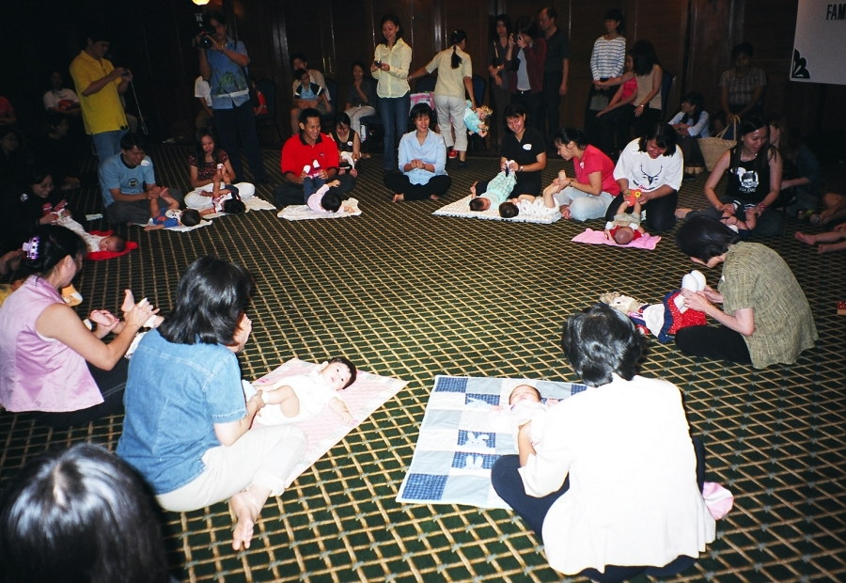
Family Music Babies – Demo Class
Wiggly, Tickling Activity – Fun, enjoyment & bonding

Slide 7
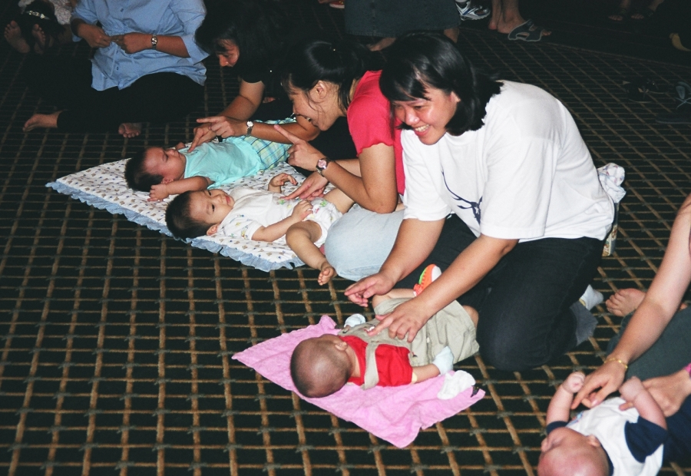
Family Music Babies – Demo Class
Body Awareness, chanting & tapping

Slide 8
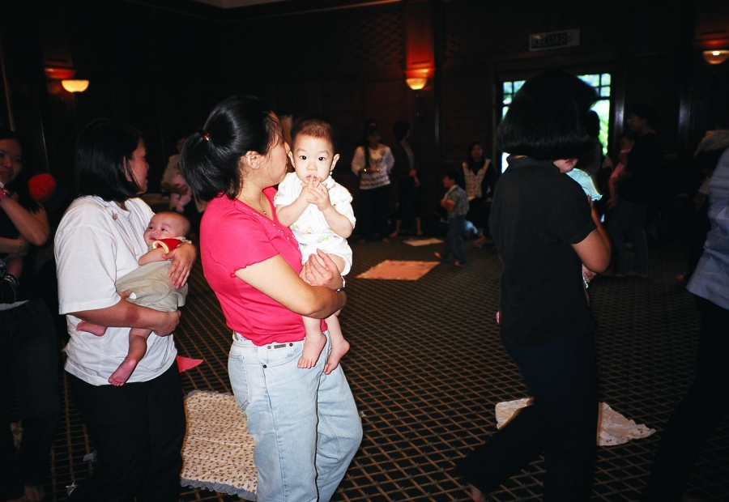
Family Music Babies – Demo Class
Dancing to recorded music

Slide 9
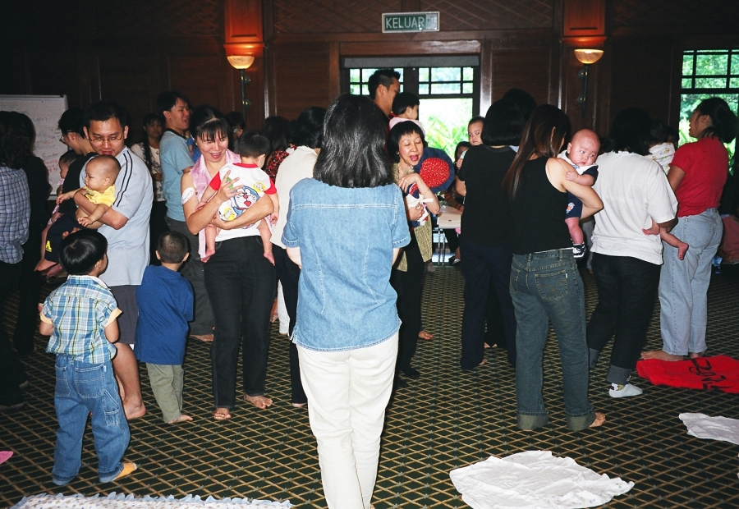
Family Music Babies – Demo Class
Rocking, Singing & Feeling the music with infant

Slide 10
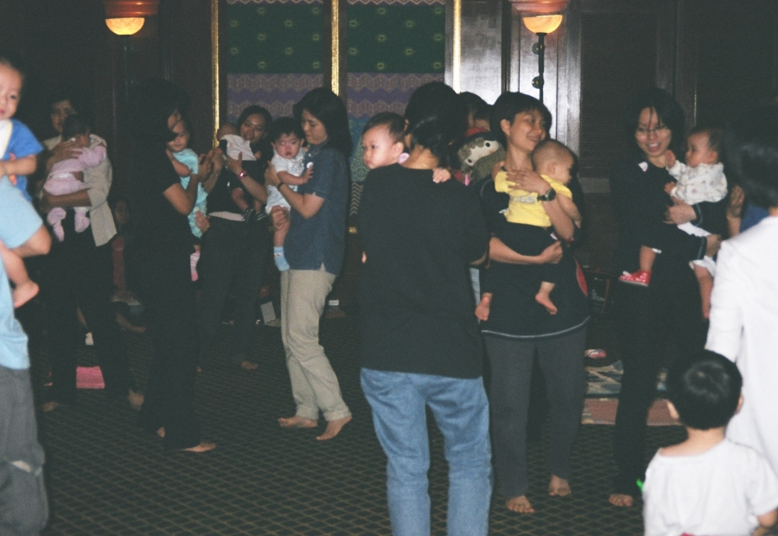
Family Music Babies – Demo Class
Feeling the music & dancing to the beat

Slide 11
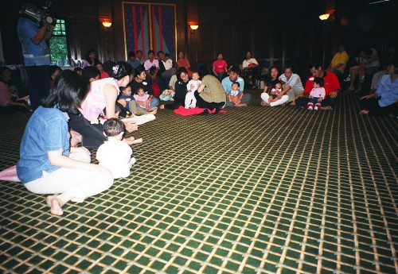
Family Music Babies – Demo Class
Goodbye Song

