Slide 1
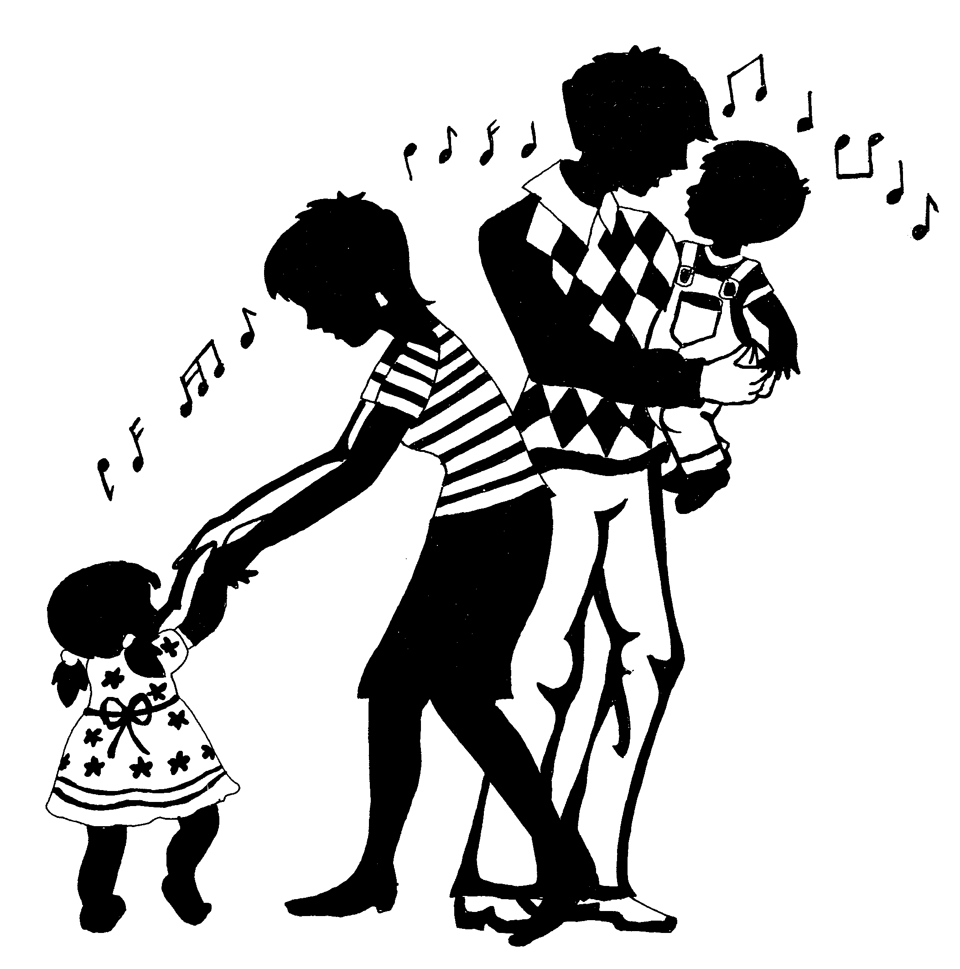
Family Music For Toddlers
(16 months – 4 Years)
COURSE DESCRIPTION
Parent and child will participate in singing, chanting, moving, dancing, listening and playing simple instruments;
Experience activities that are designed to suit the ‘moving’ child and to lay the foundation for musical growth

Slide 2
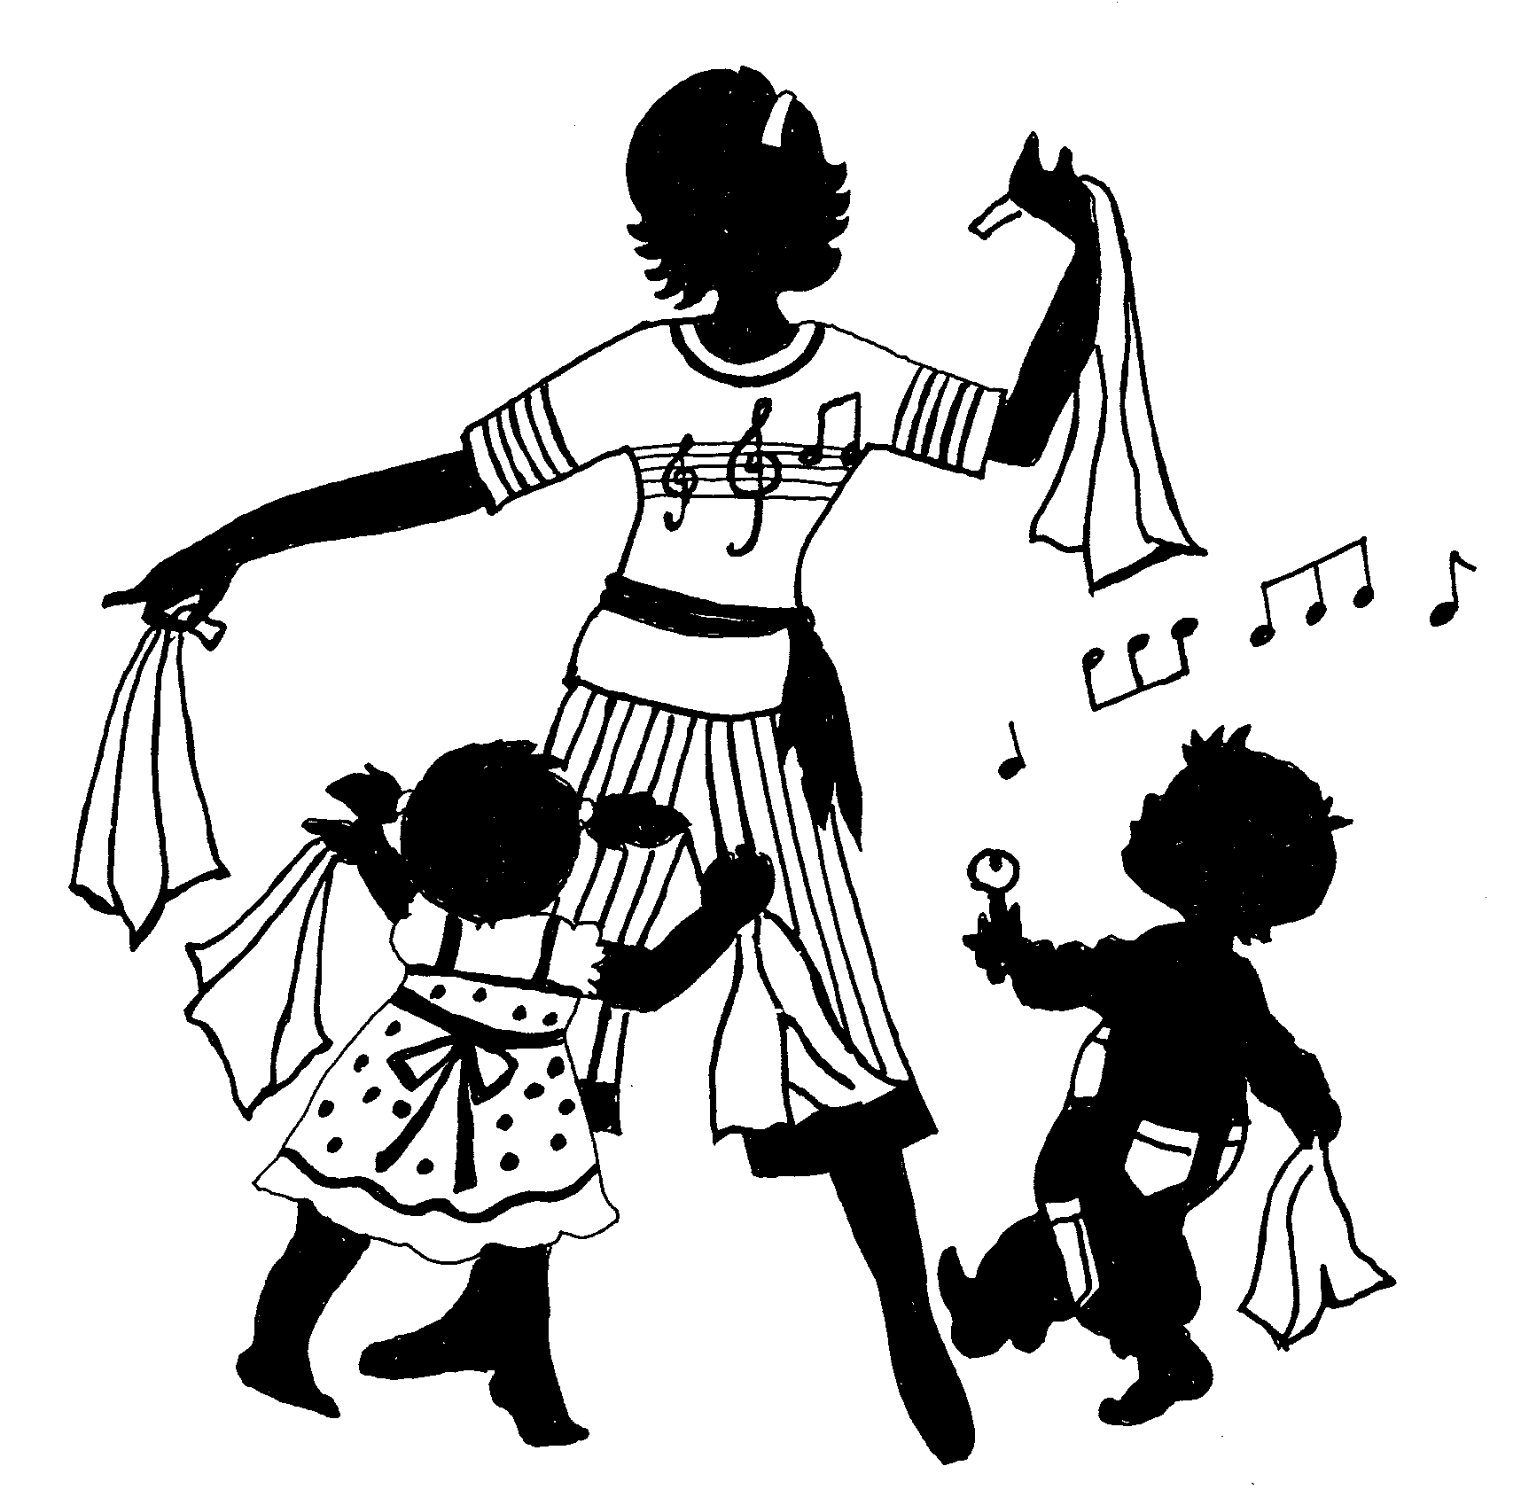
Family Music For Toddlers
(16 months – 4 Years)
BENEFITS
Nurtures bonding between parents and child;
Stimulates left & right brain development;
Lays the foundation for musical growth - develops child’s listening skills, sense of pitch, flow and beat through singing, movement, dancing & listening activities;
Parents learn how to play musically with the child
Channels the ‘moving’ child’s energy productively;
Improves memory through repetition;
Facilitates expression of feelings.

Slide 3
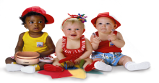

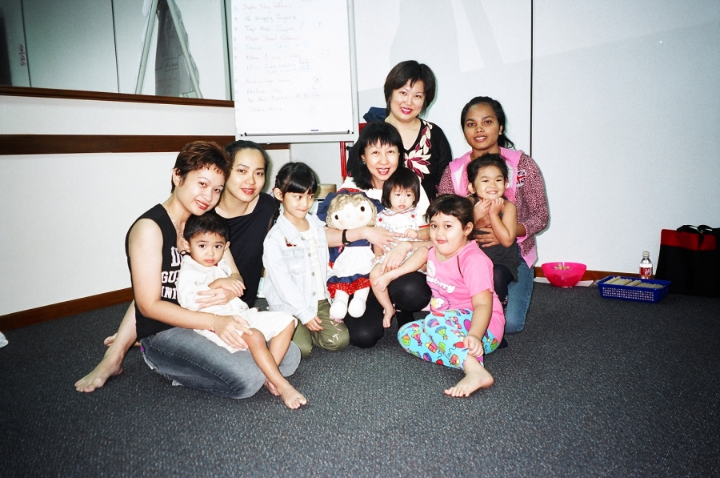
Family Music Toddlers – Demo Class
Group
Photo

Slide 4
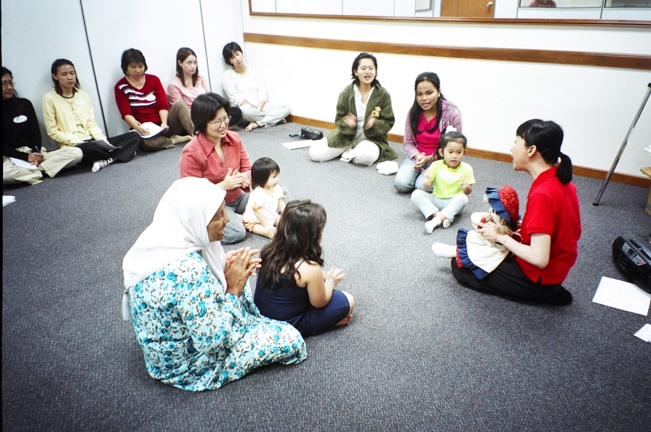
Family Music Toddlers – Demo Class
Singing &
Chanting Activity

Slide 5
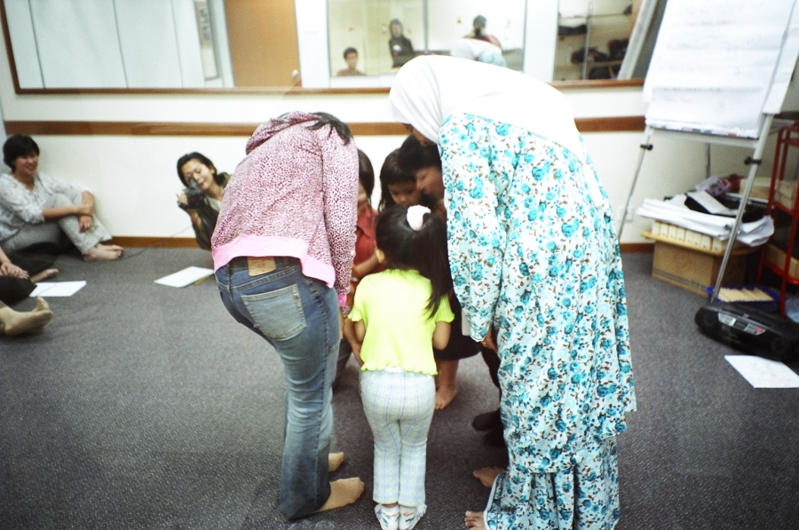
Family Music Toddlers – Demo Class
Singing Game -Travelling Movement

Slide 6
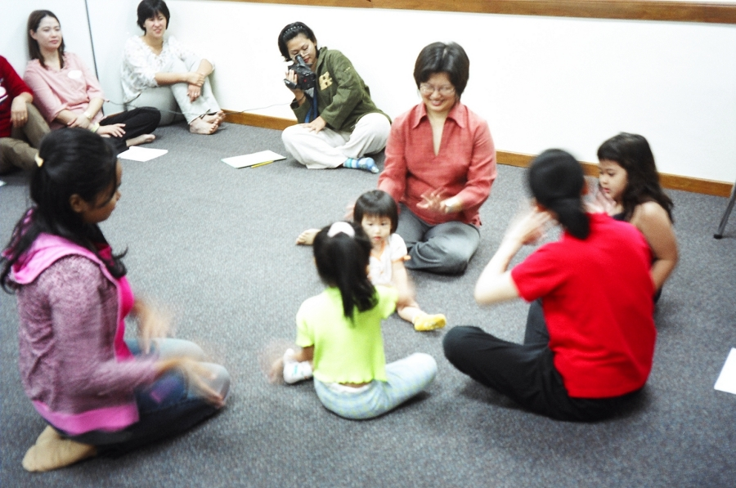
Family Music Toddlers – Demo Class
Language Development
& Stationery Movement

Slide 7
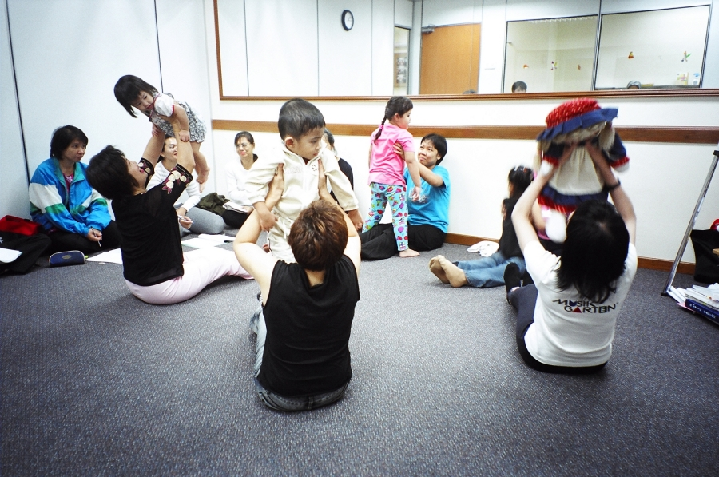
Family Music Toddlers – Demo Class
Bouncing activity with parent

Slide 8
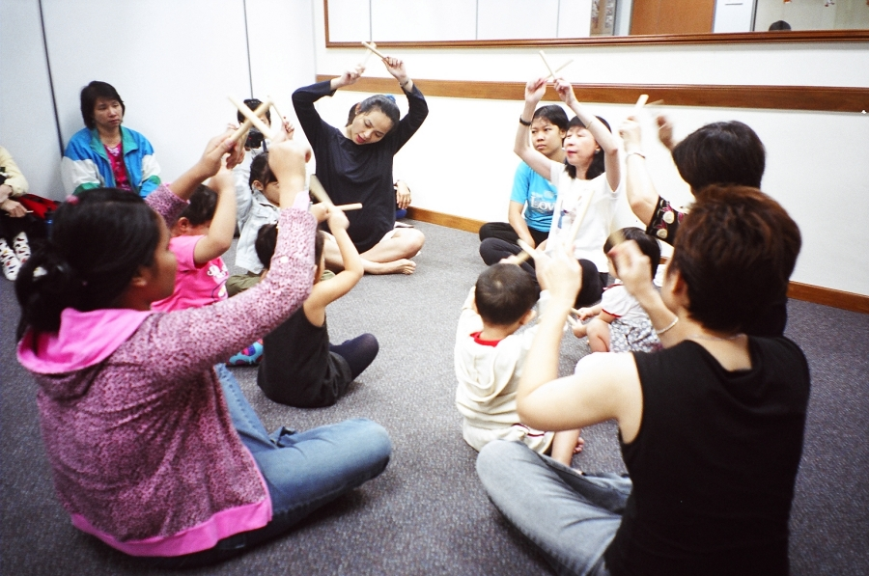
Family Music Toddlers – Demo Class
Beat Development
Using Rhythm Sticks

Slide 9
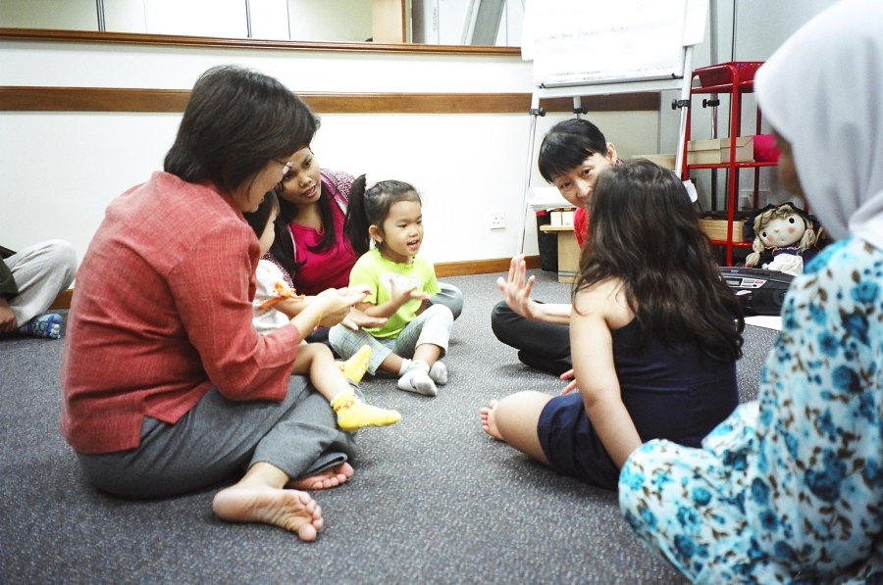
Family Music Toddlers – Demo Class
Finger Play activity to
develop fine motor skills

Slide 10
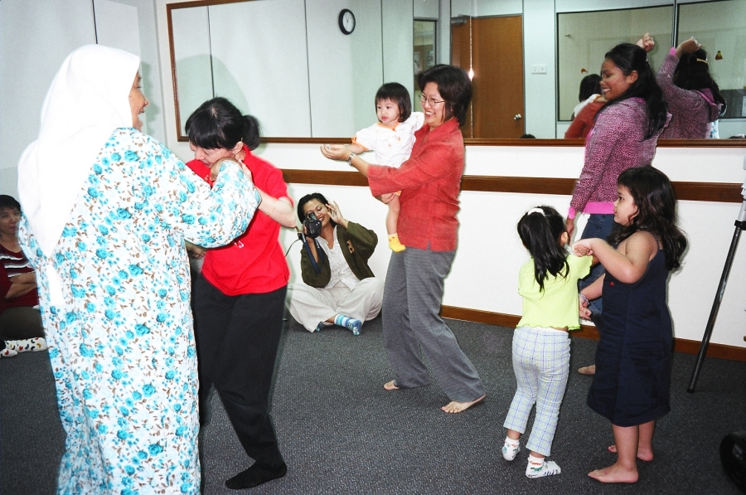
Family Music Toddlers – Demo Class
Feeling the music & dancing to the beat

Slide 11
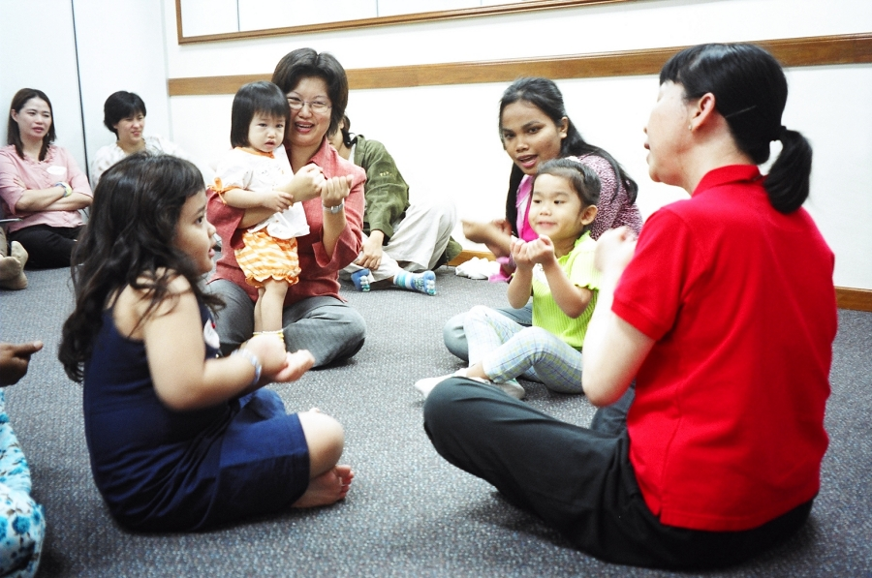
Family Music Toddlers – Demo Class
Singing & Chanting to the beat of the music

