Slide 1
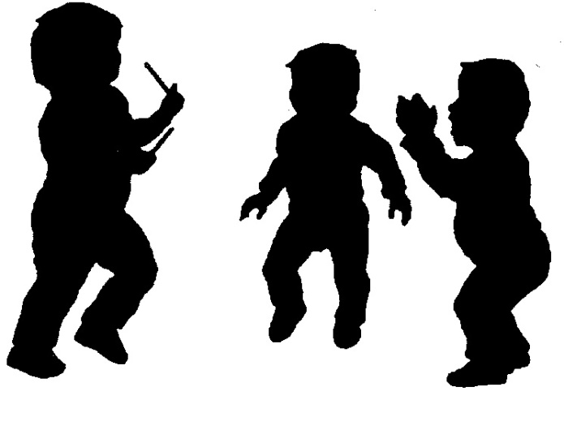
The Cycle of the Seasons
(4 – 5 ½ Years)
COURSE DESCRIPTION
Activities are built on the child’s growing independence and competencies;
Lessons include: songs, movement activities, exploration of instruments, poems and imaginative stories for children to make their own;
Group music making (ensemble)
Learn musical concepts in a sequential and progressive manner – through tonal and rhythm language.

Slide 2
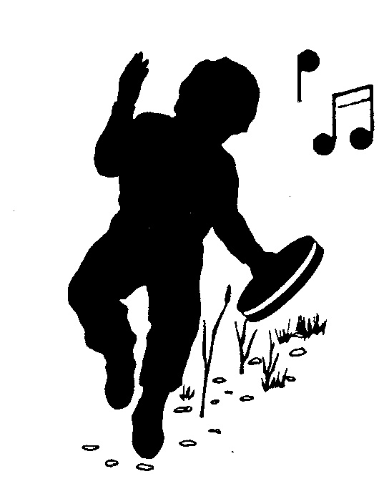
The Cycle of the Seasons
(5 ½ – 6 Years)
BENEFITS
Develops language, discipline, social skills, independence, confidence, concentration, memory, listening skills, attention & creativity through singing, dancing, story-telling, poems, dramatic play and ensemble activities;
Deeper understanding of musical concepts through more challenging activities;
Lays the musical foundation required for the next course

Slide 3
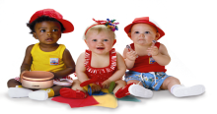

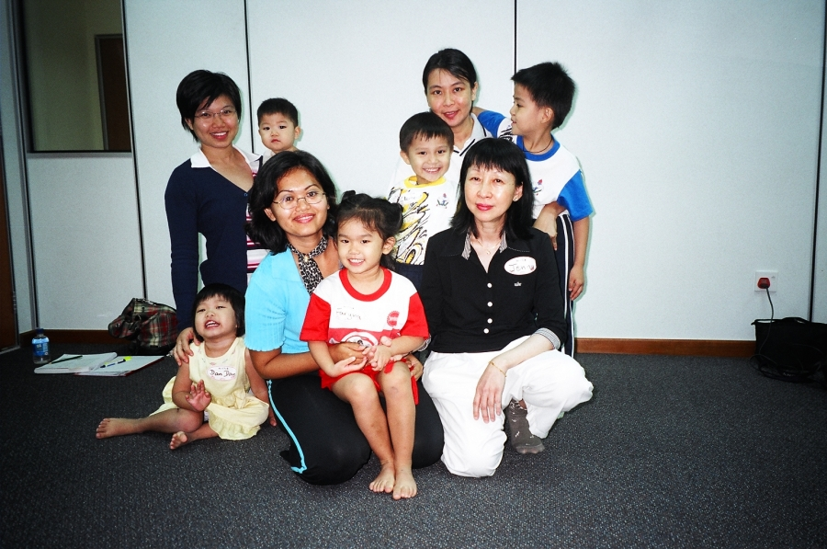
Cycle of Seasons – Demo Class
Group Photo

Slide 4
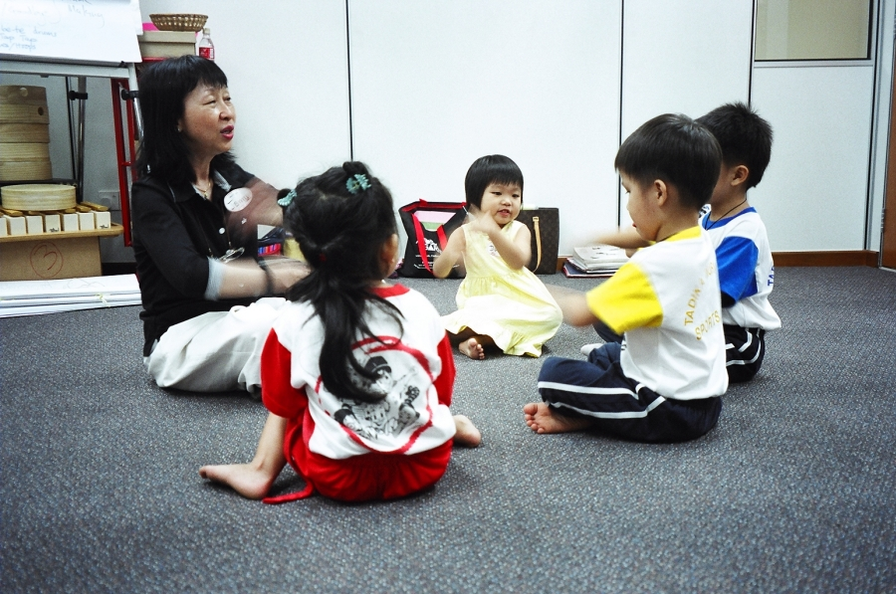
Cycle of Seasons – Demo Class
Singing &
Stationery Movement

Slide 5
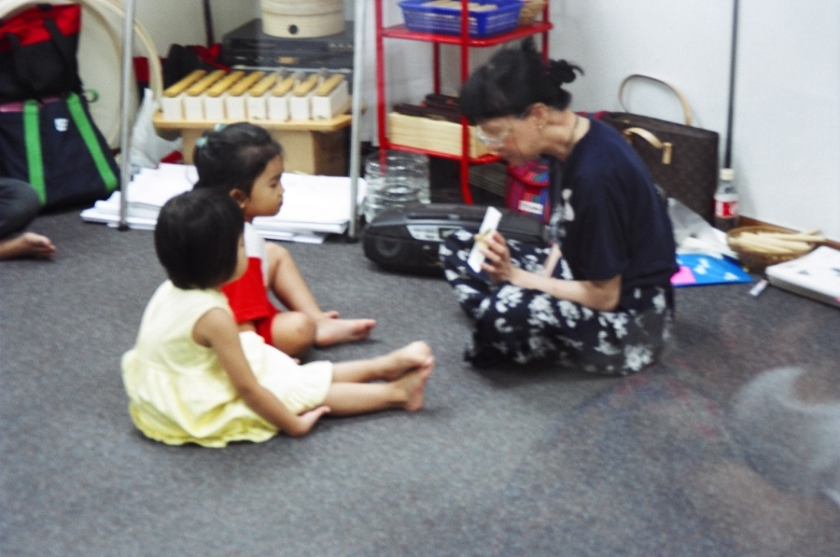
Cycle of Seasons – Demo Class
Focused Listening

Slide 6
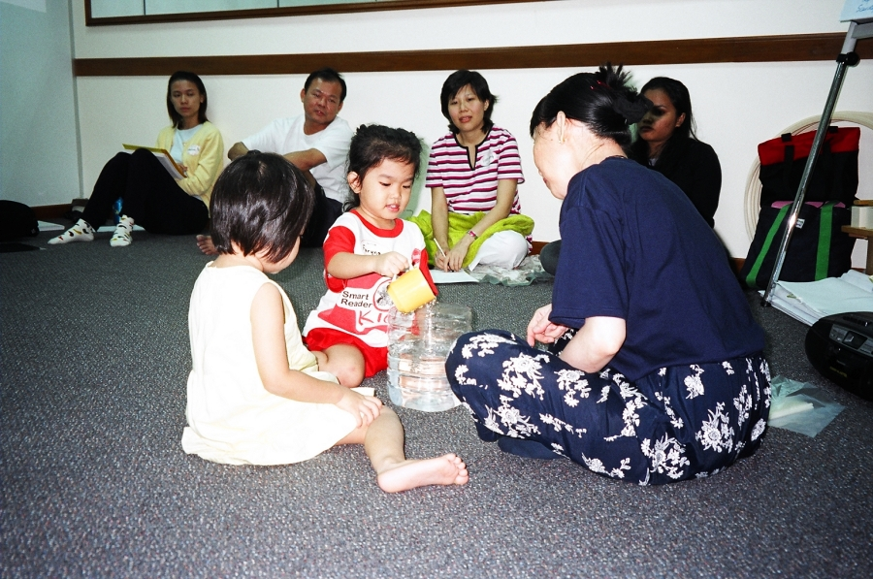
Cycle of Seasons – Demo Class
Manipulative Skills & Language Development

Slide 7
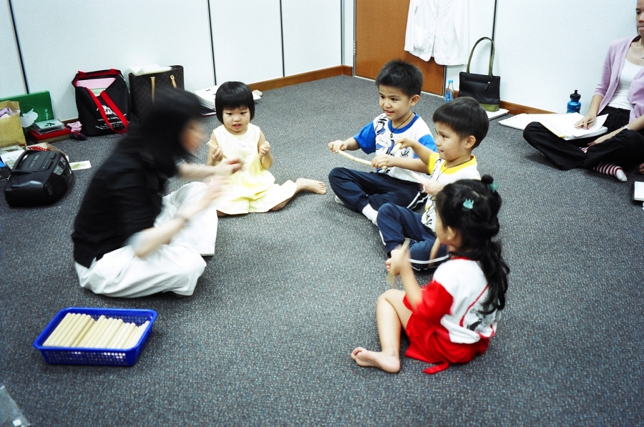
Cycle of Seasons – Demo Class
Beat Development
with Rhythm Sticks

Slide 8
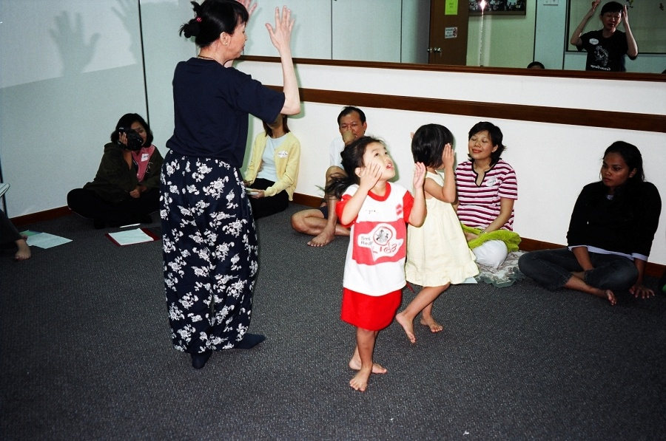
Cycle of Seasons – Demo Class
Singing & Travelling Movement

Slide 9
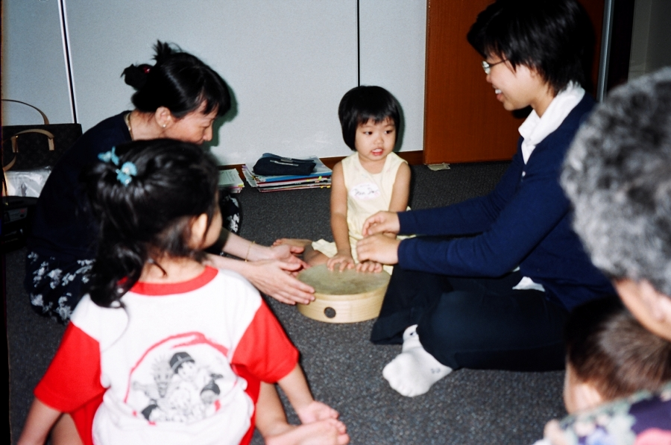
Cycle of Seasons – Demo Class
Beat Development
with Drum

Slide 10
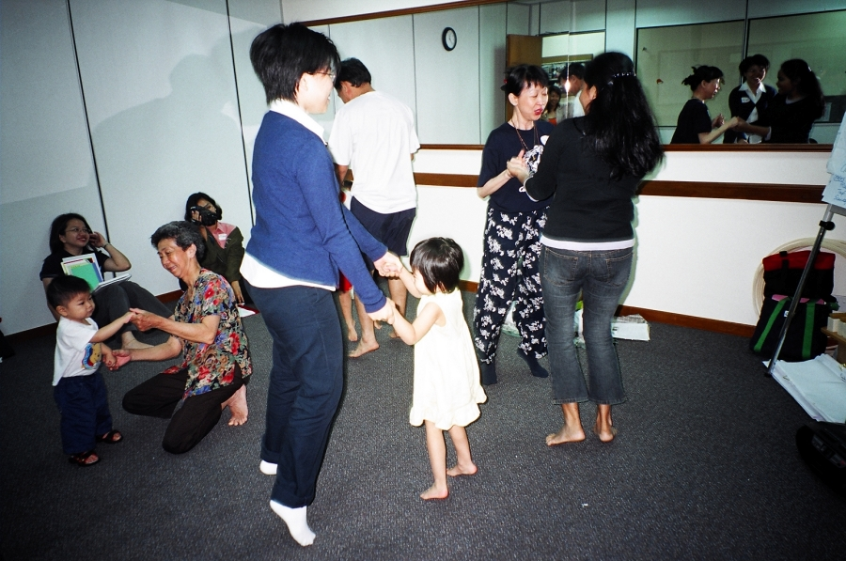
Cycle of Seasons – Demo Class
Parent’s
Sharing Time

Slide 11
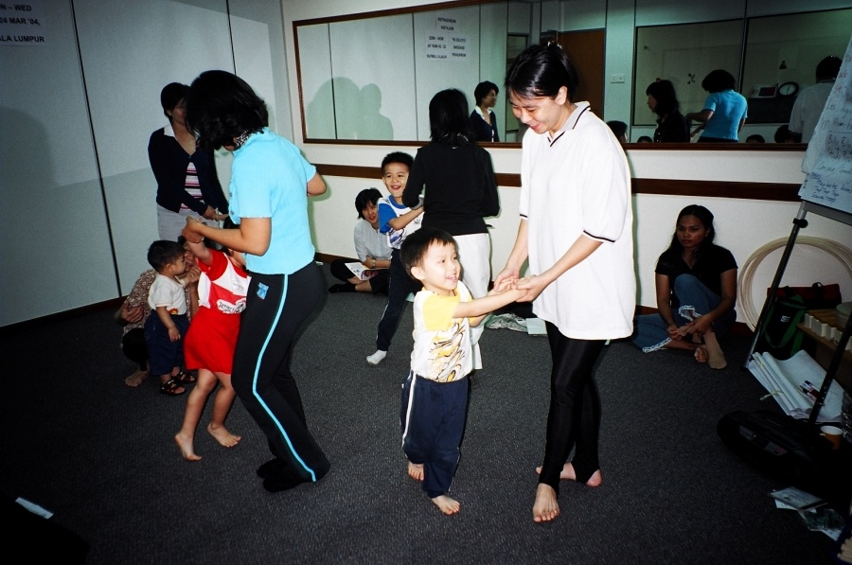
Cycle of Seasons – Demo Class
Parent’s
Sharing Time

