Slide 1
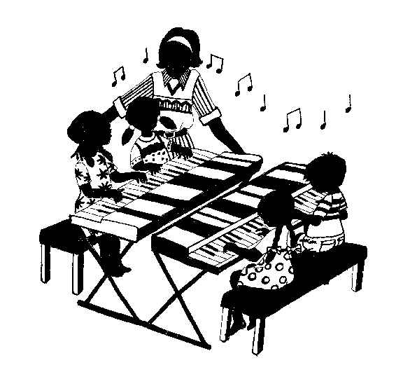
Music Makers at the Keyboard
(5 ½ – 9 Years)
DESCRIPTION
Features a variety of activities (drumming, singing, dancing, group music making, listening, musical card games ) which lay the foundation for success at the keyboard, piano & other instruments;
Lead children to ‘Music Literacy’ (see what you hear, hear what you see)
A comprehensive musicianship course –Composition, Transposition, Improvisation, Dictation; Harmony, Chord Progression & Forms in Music;
Children learn about Composers & Music of different periods (Classical and Contemporary);

Slide 2
Music Makers at the Keyboard
(5 ½ – 9 Years)
BENEFITS
Lays a strong foundation for keyboard / piano success;
Fosters excitement and pride in making music both independently and with others;
Enhances musicianship;
Sustain the love and interest for life-long instrument playing

Slide 3
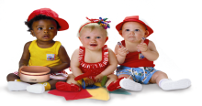

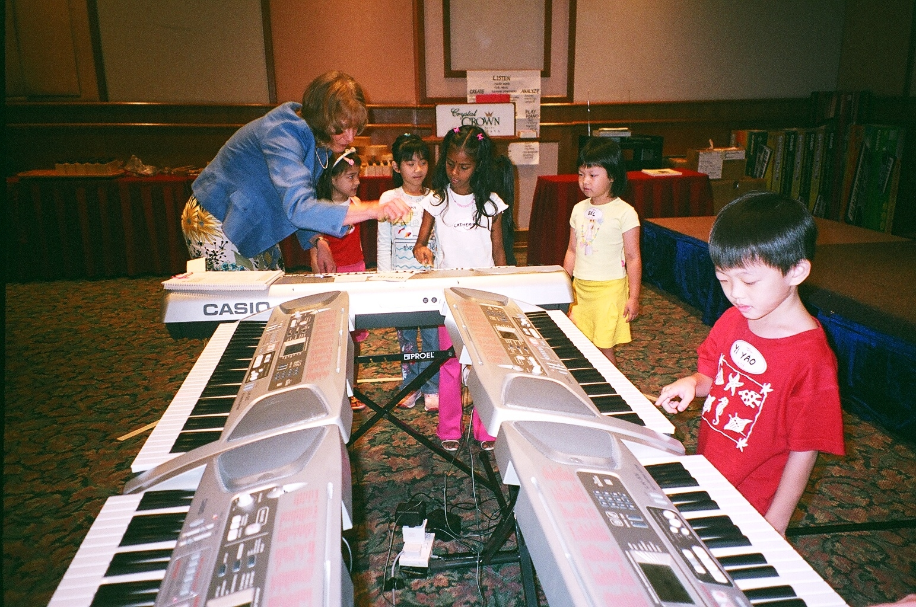
MMKB (Keyboard) – Demo Class
Exploration at Keyboard

Slide 4
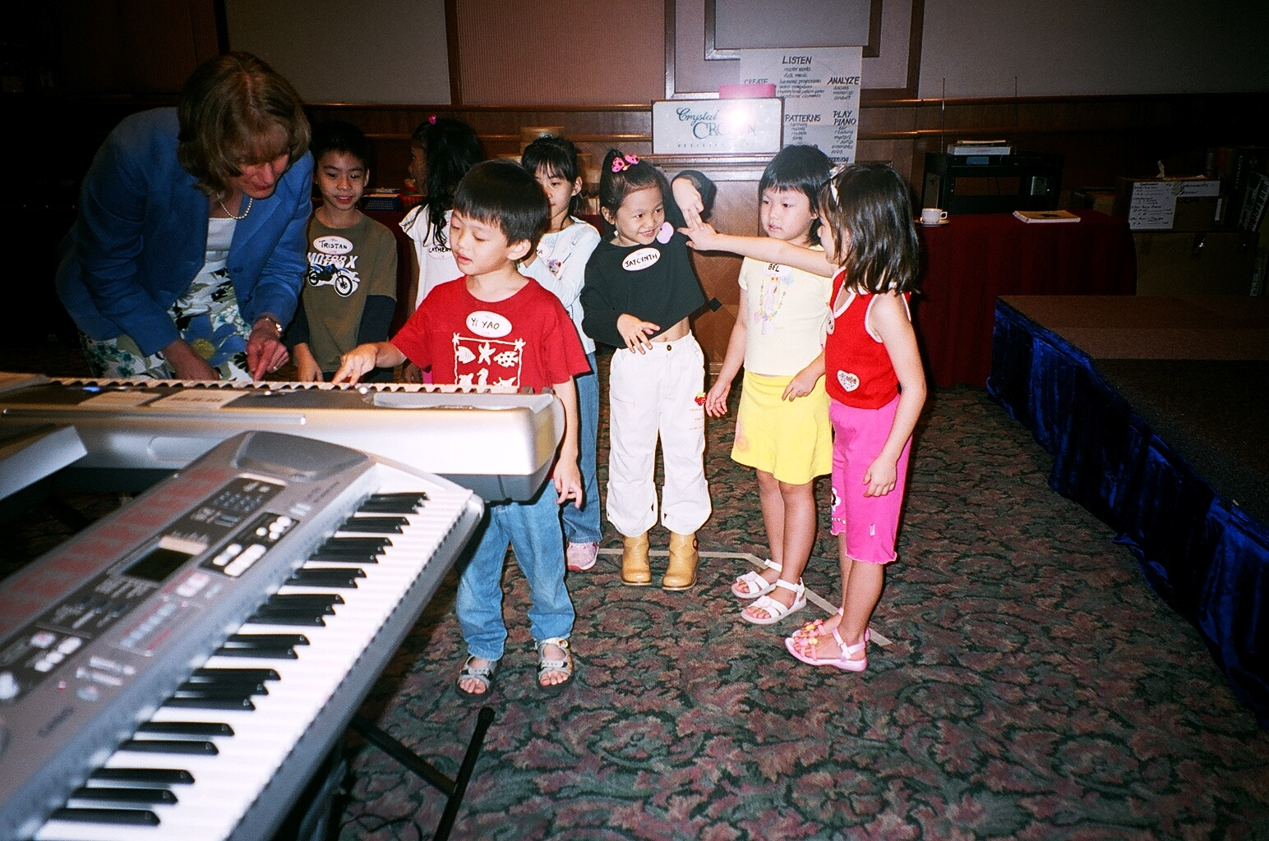
MMKB (Keyboard) – Demo Class
Exploration at Keyboard

Slide 5
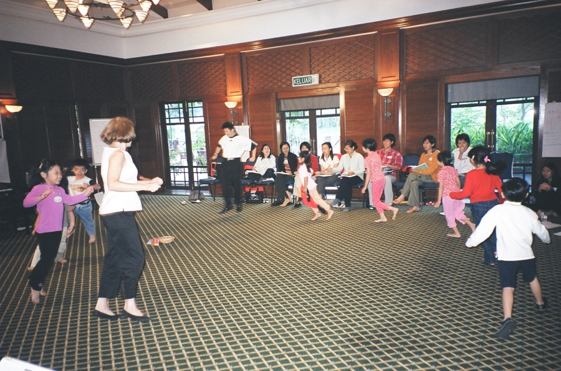
MMKB (Keyboard) – Demo Class
Singing & moving to the beat of the song

Slide 6
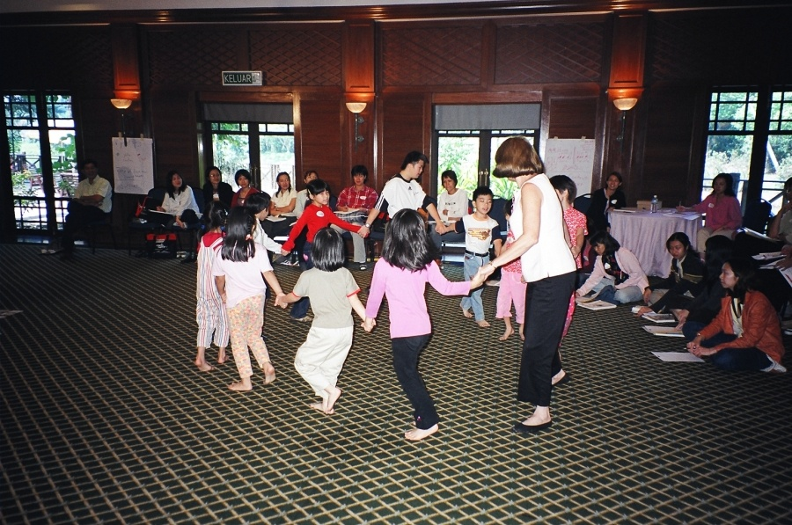
MMKB (Keyboard) – Demo Class
Experiencing a dance

Slide 7
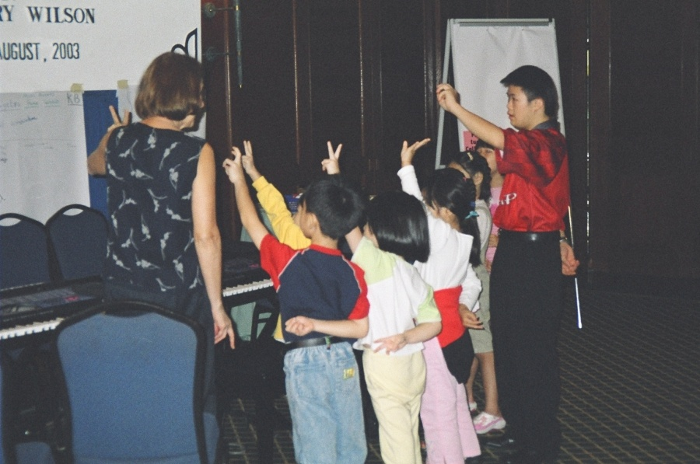
MMKB (Keyboard) – Demo Class
Fingering exercise before exploration at keyboard

Slide 8
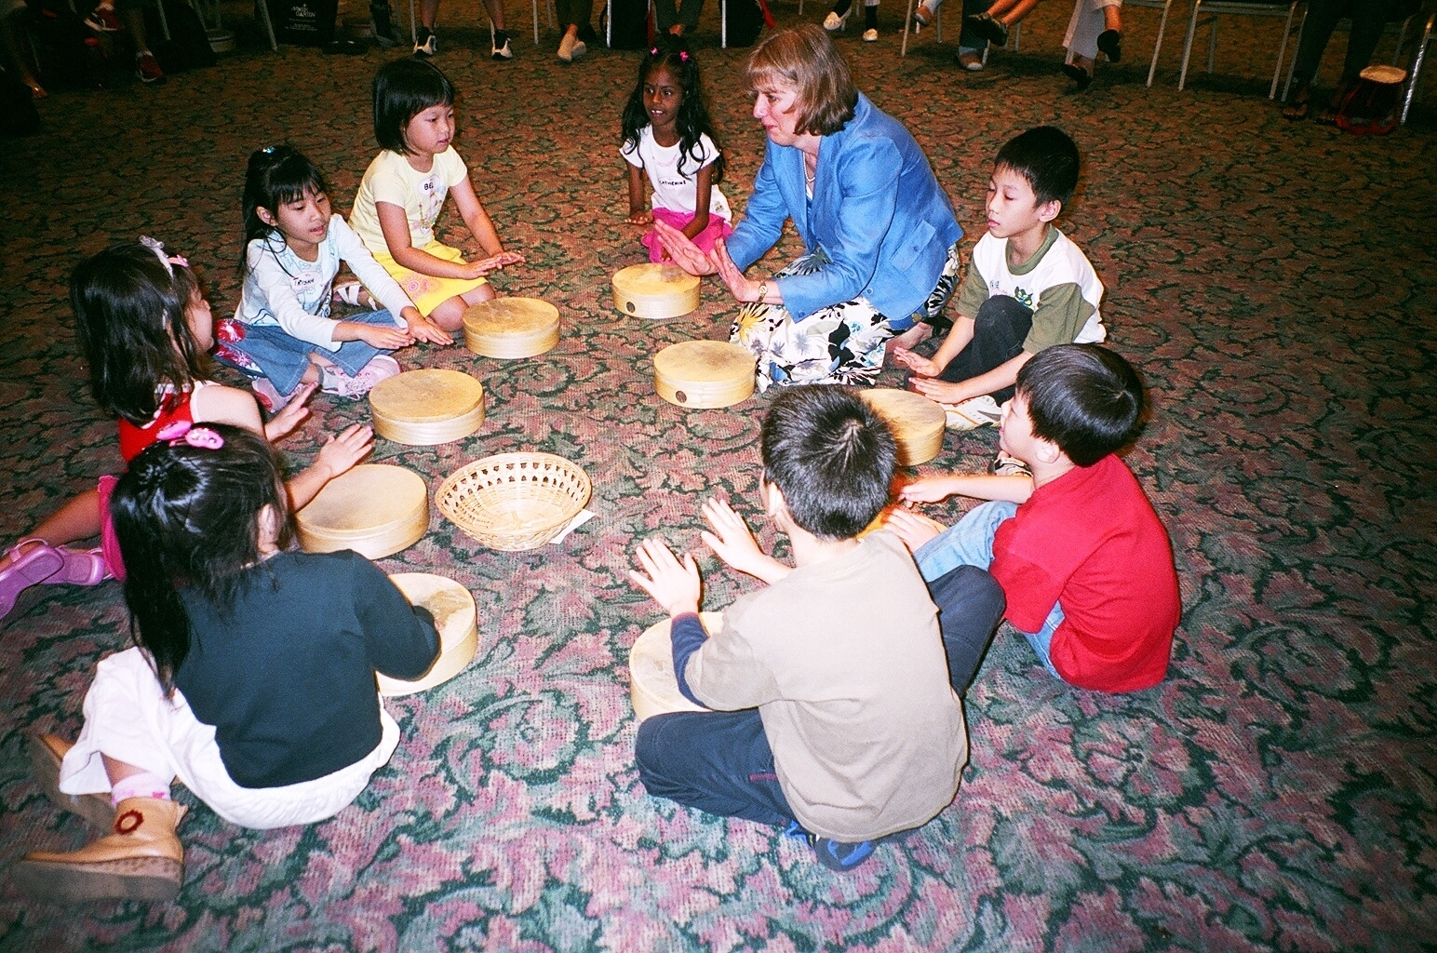
MMKB (Keyboard) – Demo Class
Rhythm games
with drum

Slide 9
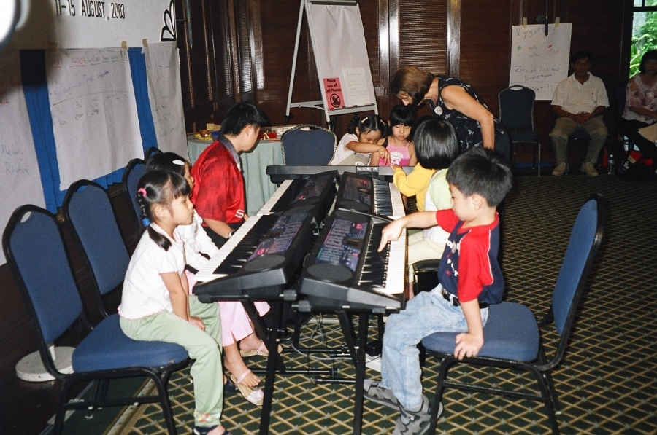
MMKB (Keyboard) – Demo Class
Introduction to geography
of the Keyboard

Slide 10
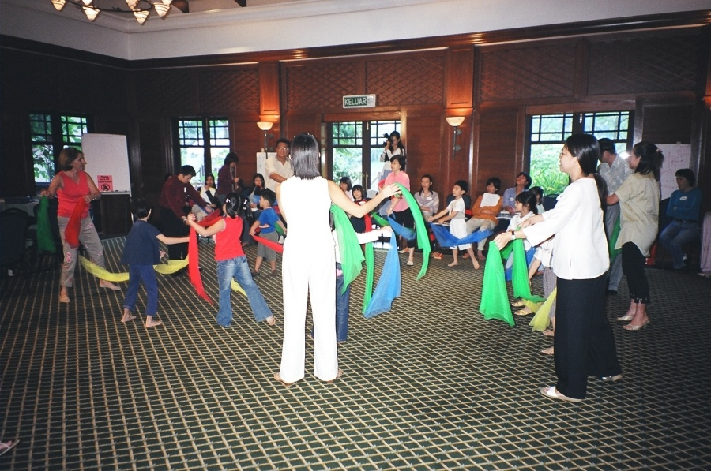
MMKB (Keyboard) – Demo Class
Parent Sharing Time

Slide 11
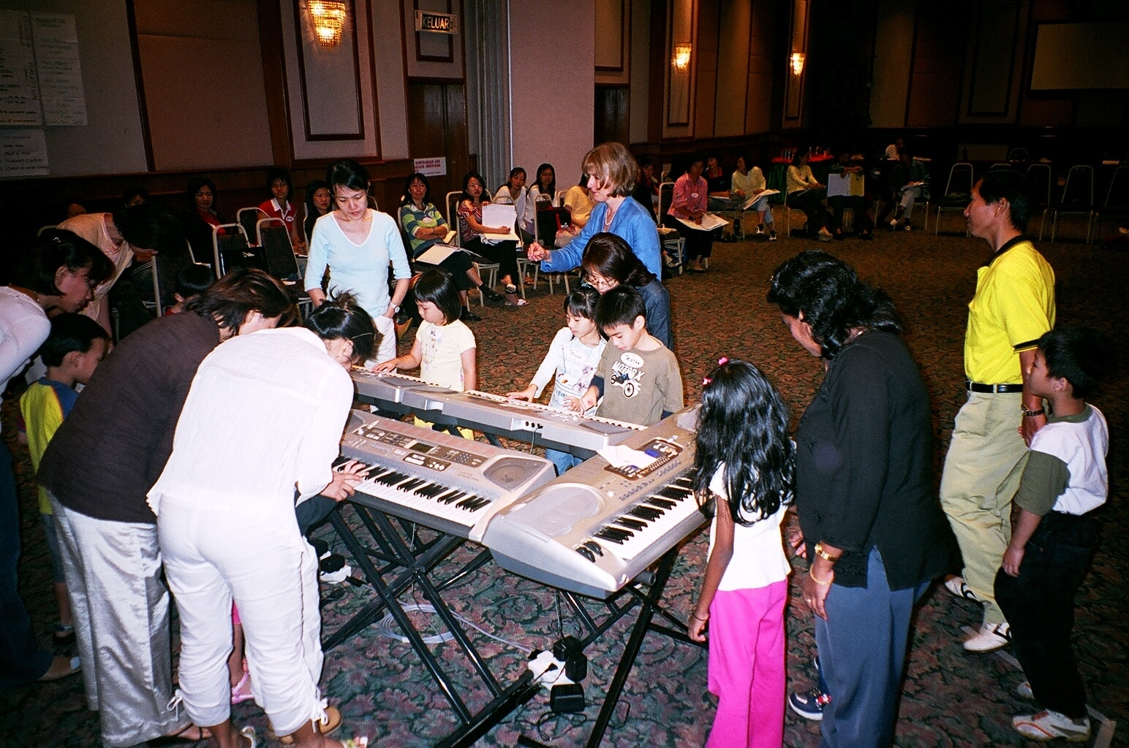
MMKB (Keyboard) – Demo Class
Parent Sharing Time

Slide 12
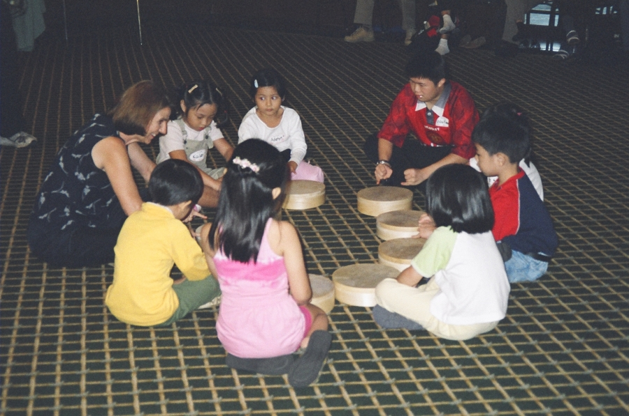
MMKB (Keyboard) – Demo Class
Beat Development with Drums

Slide 13
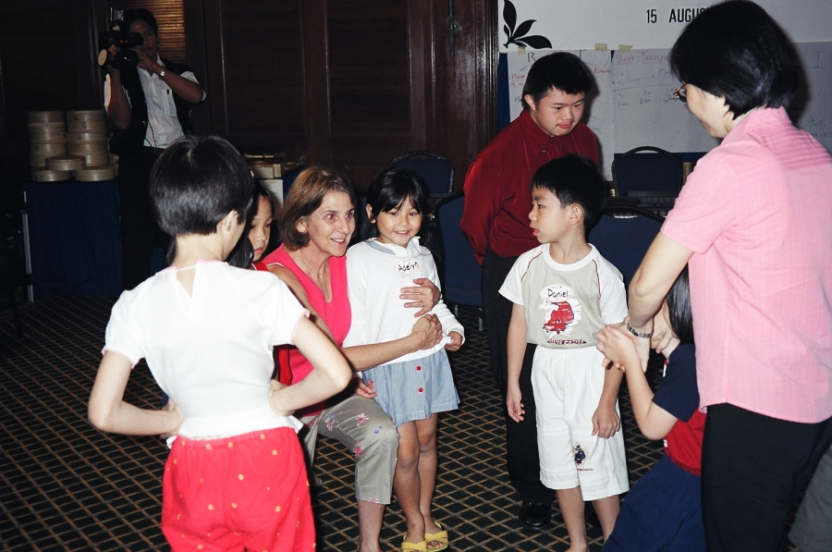
MMKB (Keyboard) – Demo Class
Goodbye to the teacher

